Slide 1


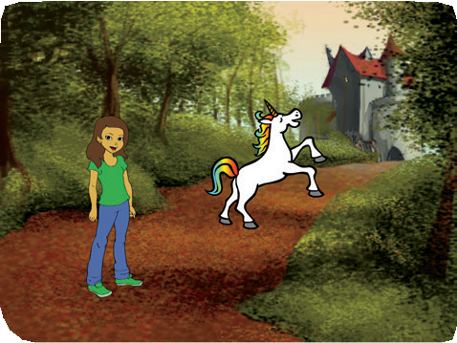
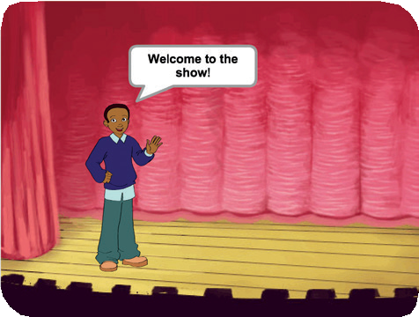
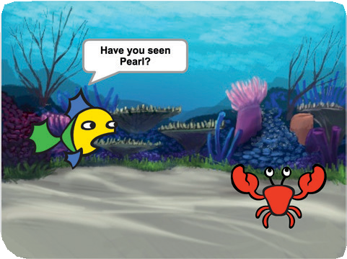
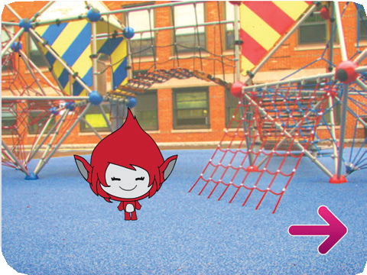

Create a Story
Create a Story 1
Cards
Choose characters, add conversation, and bring your story to life.
scratch.mit.edu/story

Slide 2
Create a Story
Create a Story 2
Cards
Start with the first card and then try the other cards in any order:
Start a Story
Show a Character Make a Conversation Switch Scenes
Glide to a Spot Appear in a Scene Make It Interactive Add Your Voice Click a Button
scratch.mit.edu/story

Slide 3
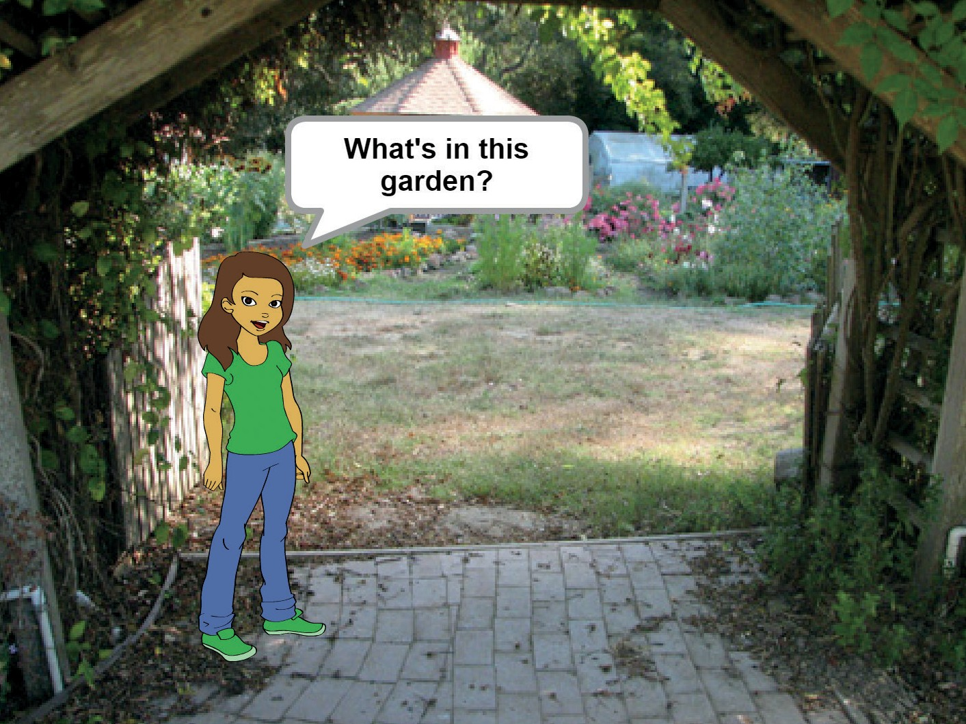
Start a Story
Choose a scene and introduce a character.
Create a Story
1

Slide 4

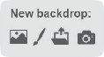



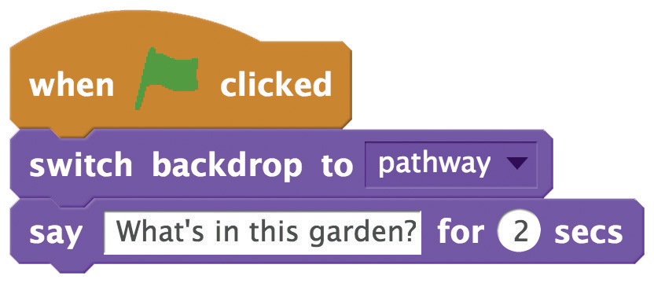


Start a Story
scratch.mit.edu/story
GET READY
Choose a character.
Choose a backdrop.
ADD THIS CODE
Type what you want your character to say.
TRY IT
Click the green flag to start.

Slide 5
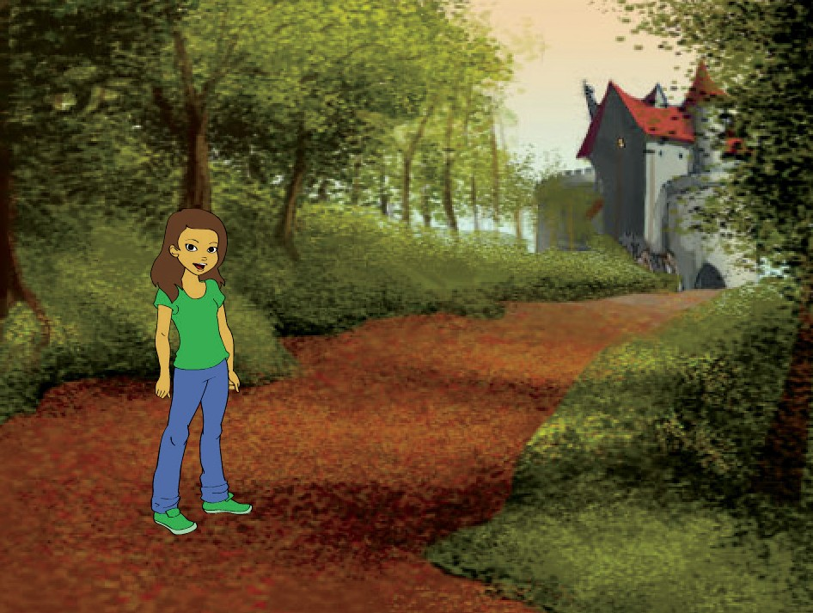
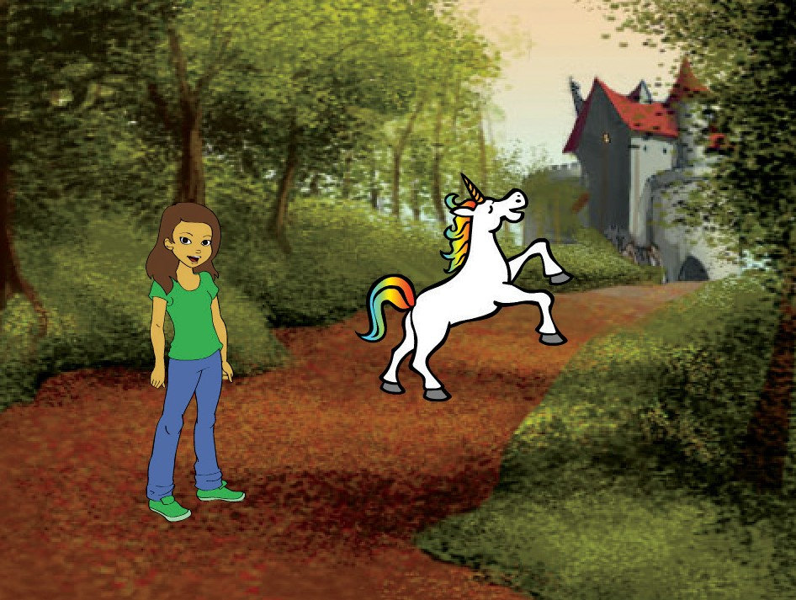
Show a Character
Make a new character appear in the scene.
Create a Story
2

Slide 6


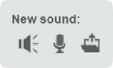


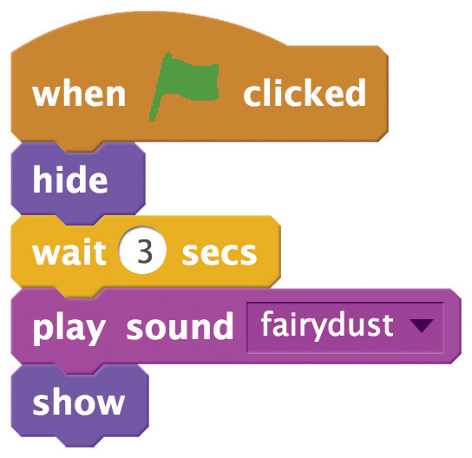

Show a Character
scratch.mit.edu/story
GET READY
Choose a character.
Click the
tab.
Then choose a sound, like fairydust.
ADD THIS CODE
Click the tab.
TRY IT
Click the green flag to start.

Slide 7
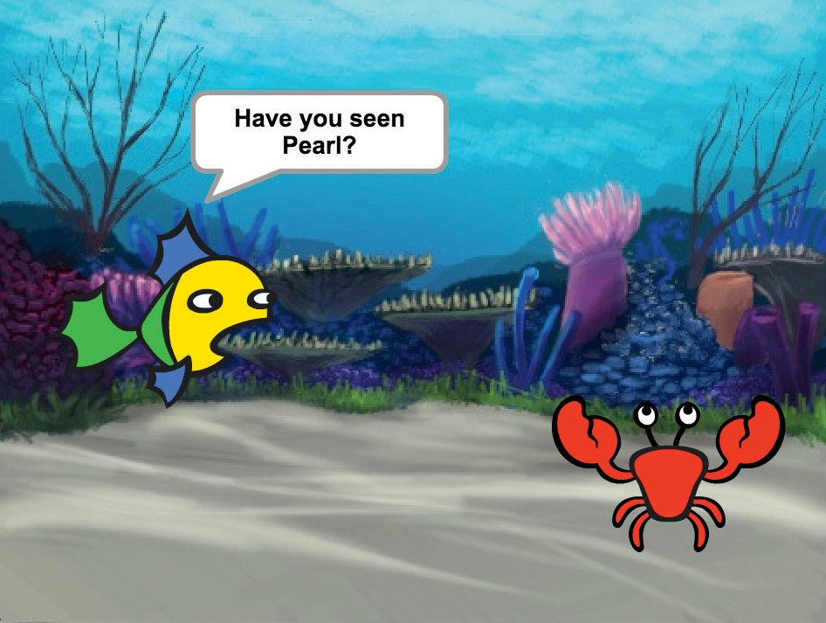
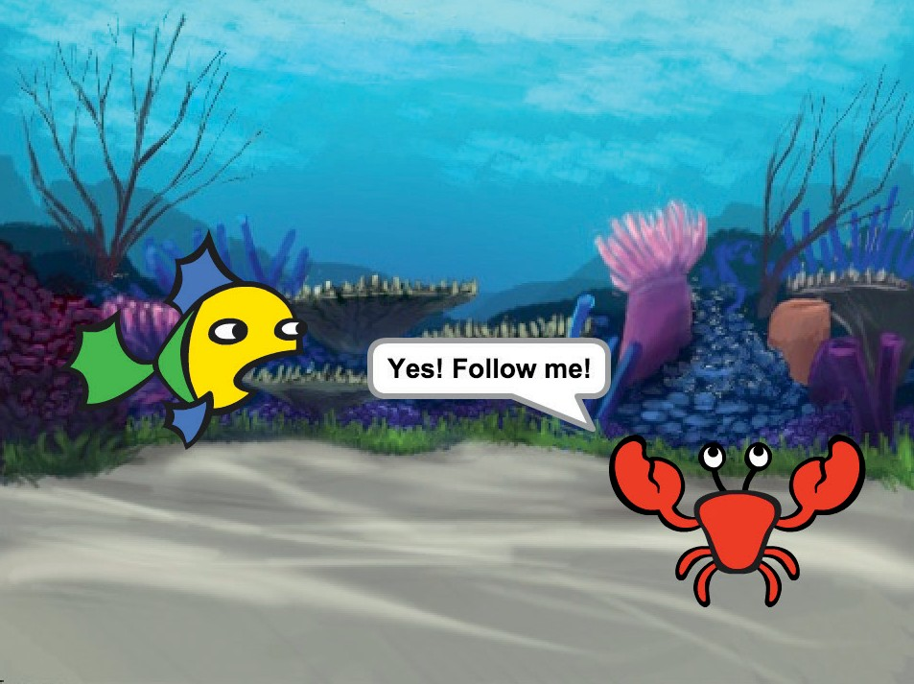
Make a Conversation
Make your characters talk with each other.
Create a Story
3

Slide 8



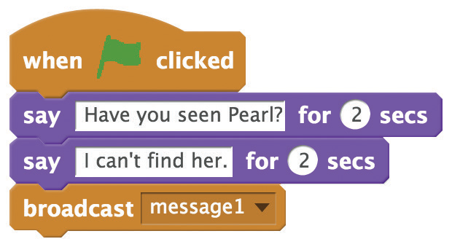

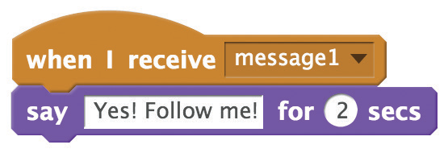


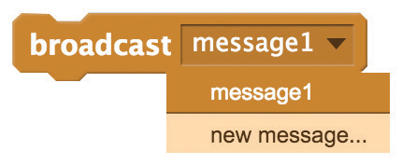
Make a Conversation
scratch.mit.edu/story
GET READY
Choose two characters.
ADD THIS CODE
Broadcast a message.
Tell this character what to do when it receives the message.
TRY IT
Click the green flag to start.
TIP
You can click the drop-down menu to add a new message.

Slide 9
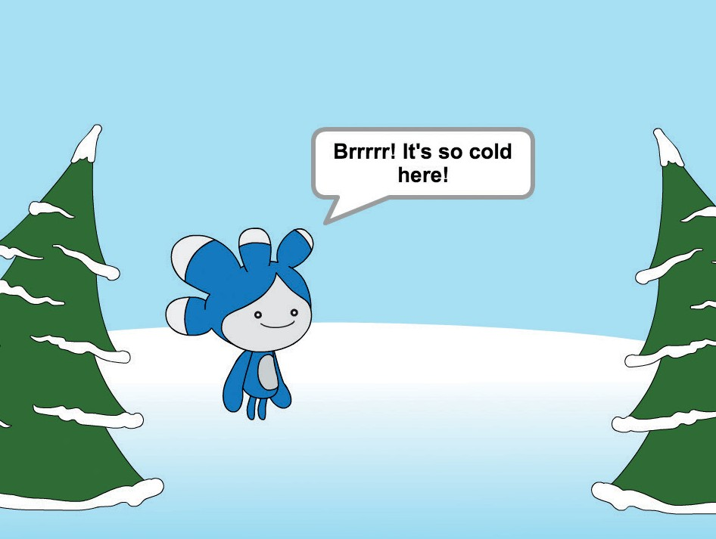
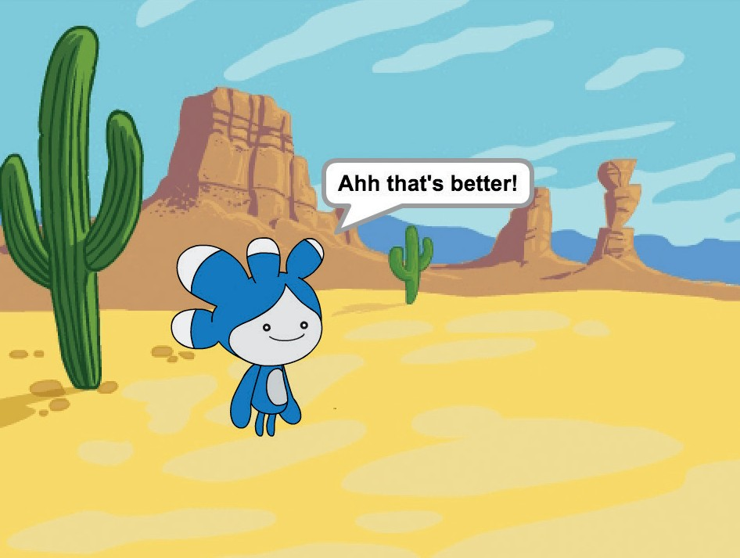
Switch Scenes
Change the backdrop and make something happen.
Create a Story
4

Slide 10
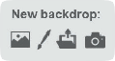
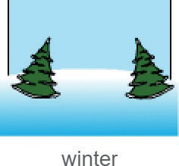

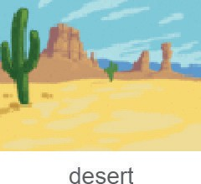
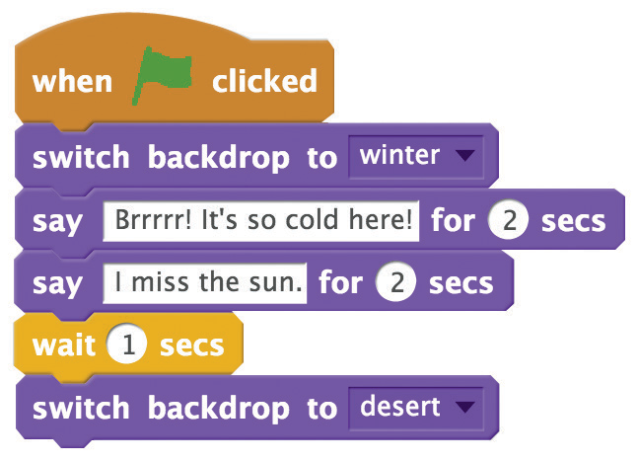

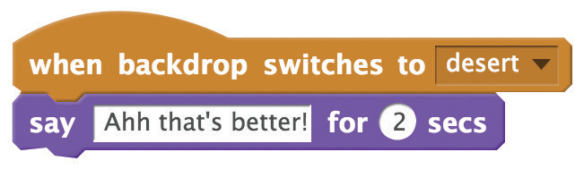

Switch Scenes
scratch.mit.edu/story
GET READY
Choose a character.
Choose two backdrops.
ADD THIS CODE
Type what you want your
character to say.
Make something happen when the backdrop switches.
TRY IT
Click the green flag to start.

Slide 11



Glide to a Spot
Make a character glide across the screen.
Create a Story
5

Slide 12
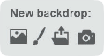



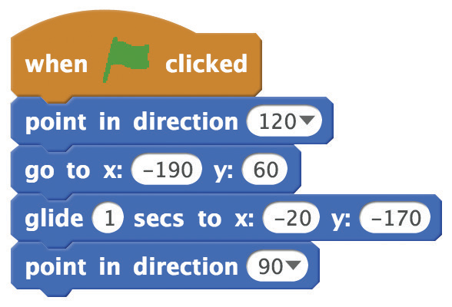

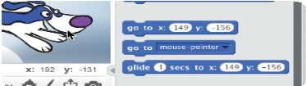
Glide to a Spot
scratch.mit.edu/story
GET READY
Choose a backdrop.
Choose a character.
ADD THIS CODE
Set a starting point. Glide to another point.
TIP
Drag your sprite to where you want it and then add a go to or a glide block to your script.
When you drag a sprite, its x and y position will
update in the Blocks palette.

Slide 13
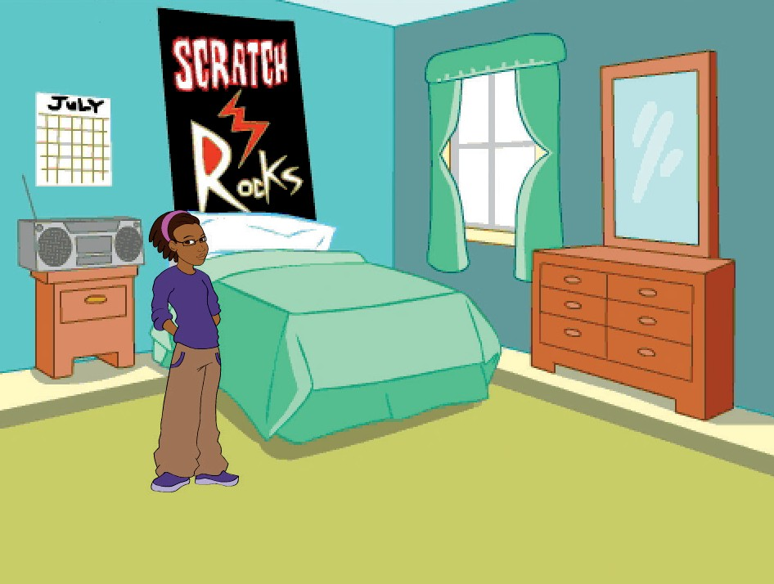
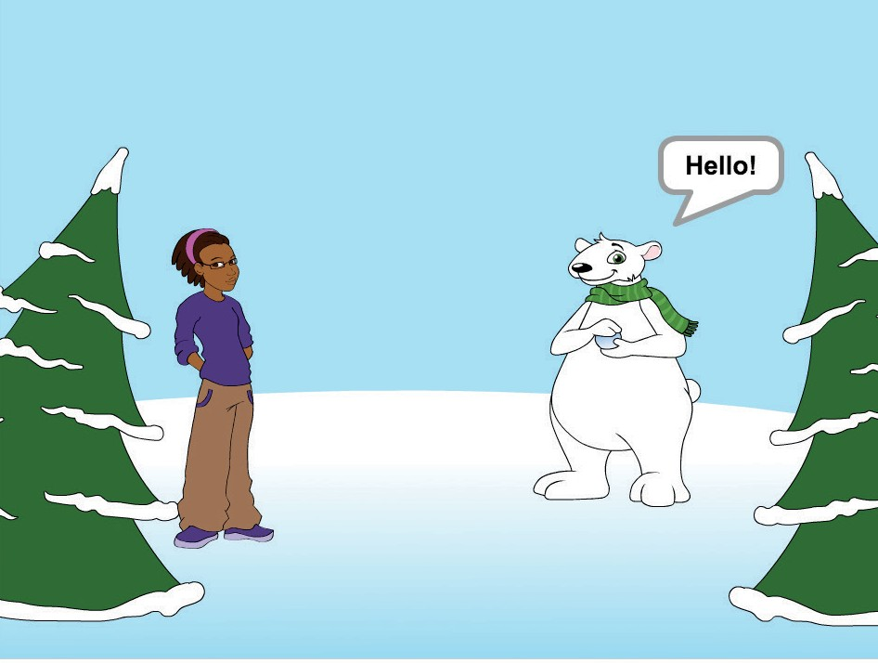
Appear in a Scene
Change the backdrop and make a new character appear.
Create a Story
6

Slide 14
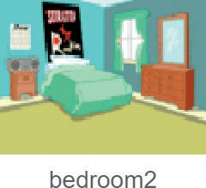
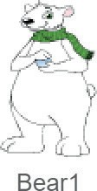
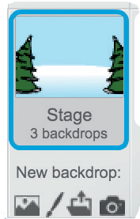


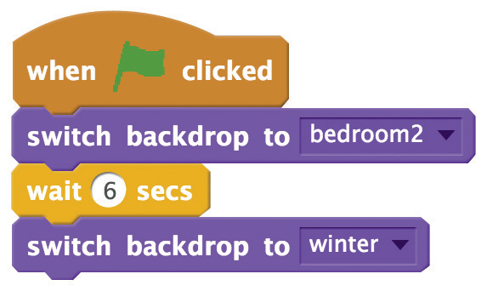
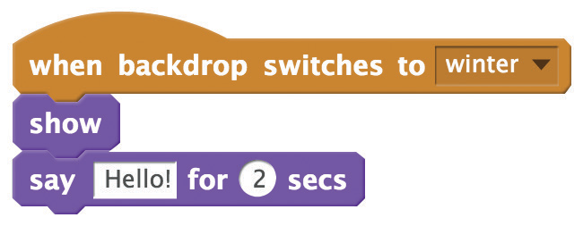

Appear in a Scene
scratch.mit.edu/story
GET READY
Choose a character.
Choose two backdrops.
ADD THIS CODE
Click the Stage thumbnail.
Hide at the beginning.
Switch to this scene.
Appear in this scene.
TRY IT
Click the green flag to start.

Slide 15
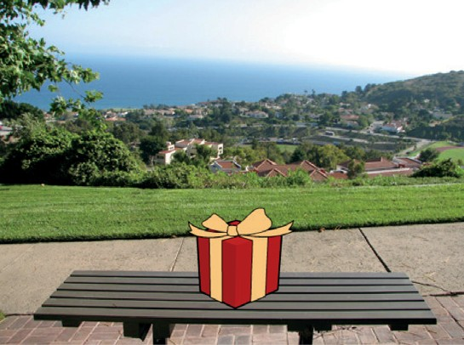
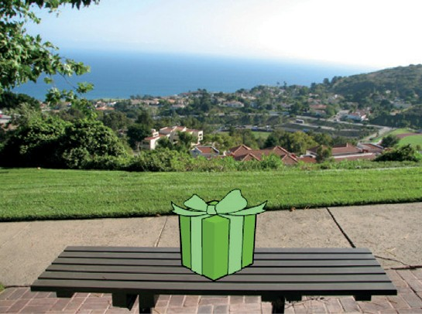
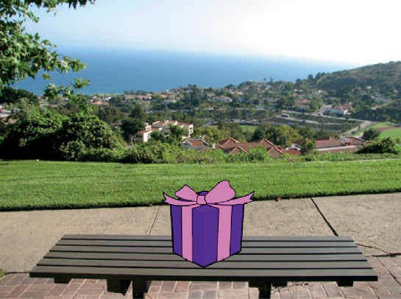
Make It Interactive
Click a sprite to make it do something.
Create a Story
7

Slide 16


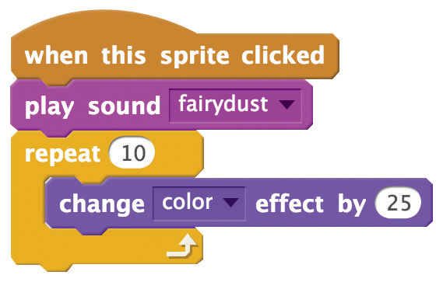

Make It Interactive
scratch.mit.edu/story
GET READY
Choose a sprite.
Click the
tab.
Then choose a sound from the Sound library.
ADD THIS CODE
Click the tab.
Choose your sound.
You can select different effects from the menu.
TRY IT
Click your sprite to start.
TIP
To clear the effect,
click the stop sign.

Slide 17
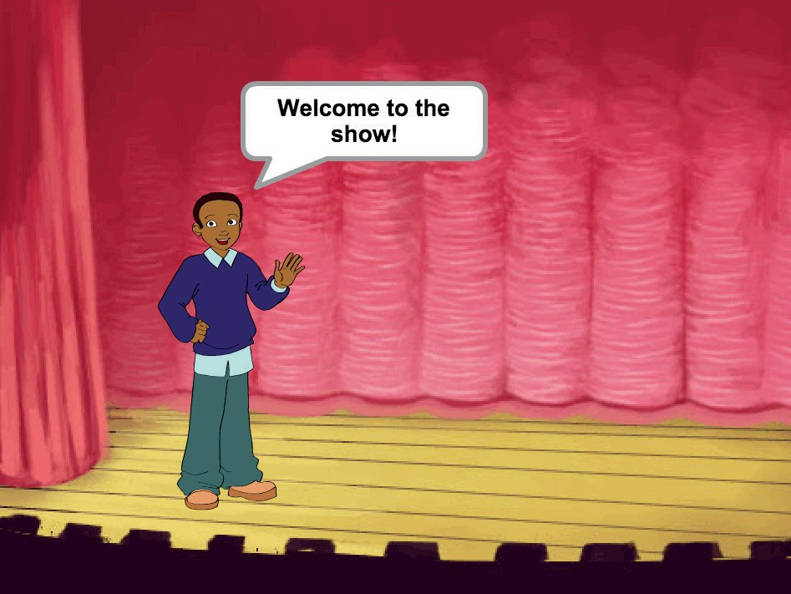
Add Your Voice
Record your voice to make a character talk.
Create a Story
8

Slide 18



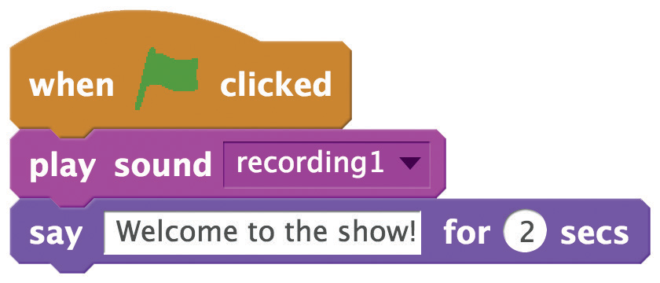

Add Your Voice
scratch.mit.edu/story
GET READY
Click the
Choose a character.
tab.
Click this icon. (You’ll need a microphone.)
Click to record your voice.
ADD THIS CODE
Click the tab.
TRY IT
Click the green flag to start.

Slide 19
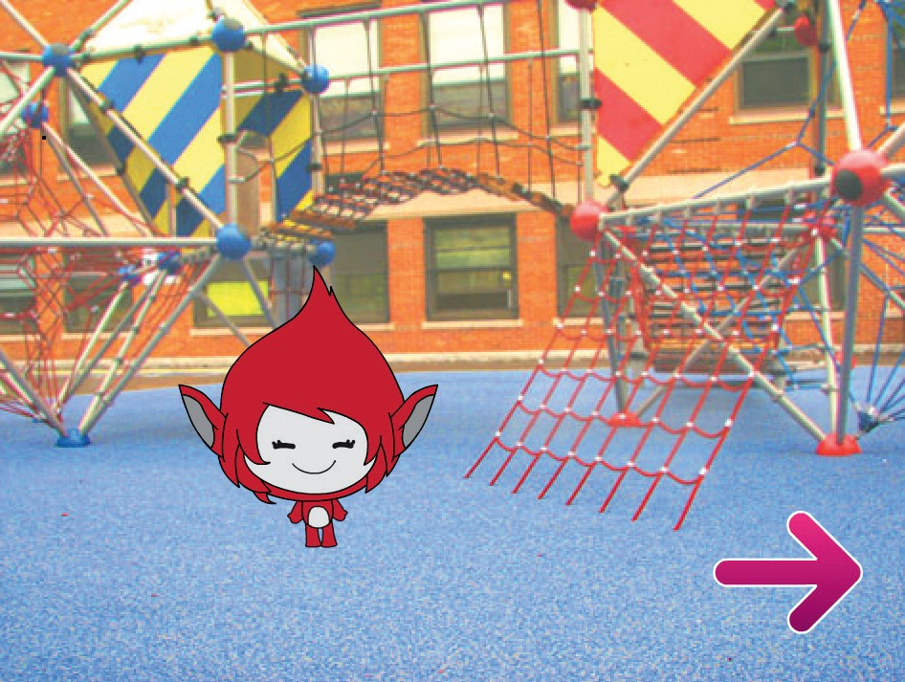
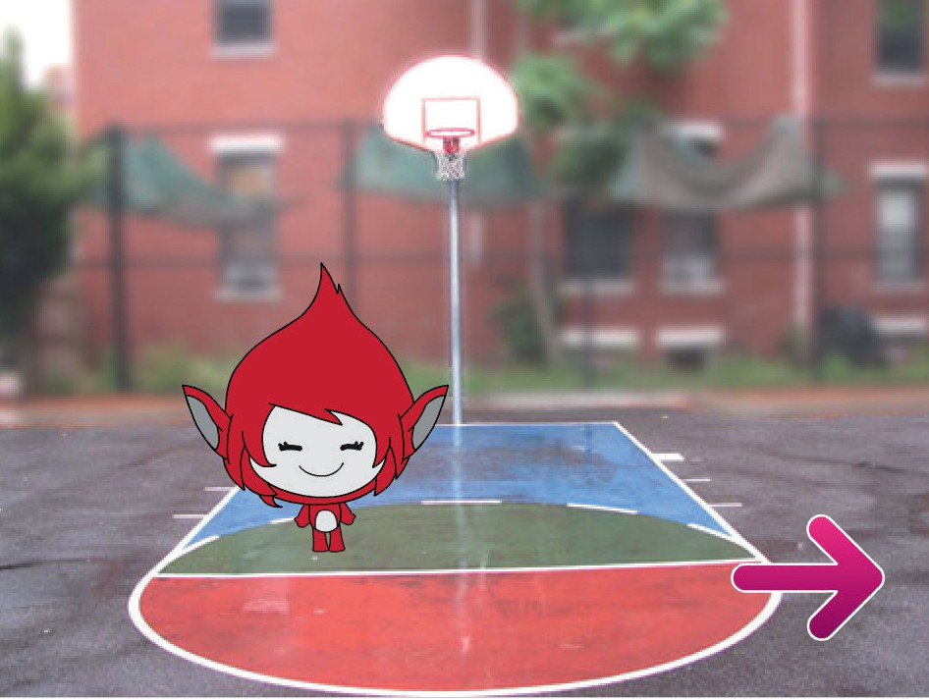
Click a Button
Click a button to switch scenes.
Create a Story
9

Slide 20
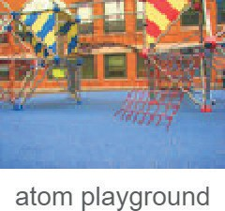
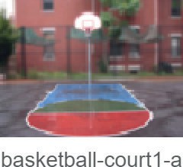


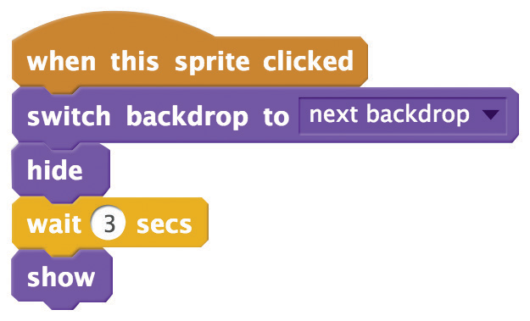

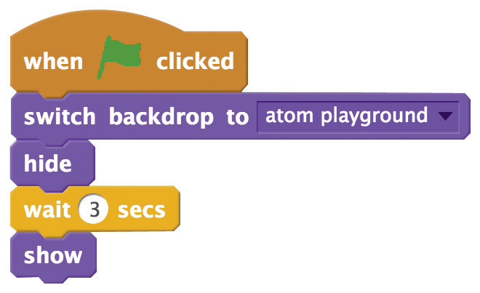
Click a Button
scratch.mit.edu/story
GET READY
Choose a button sprite, like Arrow1.
Choose two backdrops.
ADD THIS CODE
Choose next backdrop
from the menu.
Type how long to wait before showing the button.
TRY IT
Click your button to start.
TIP
Add this script to set the first scene. Then click the green flag to start.

